Slide 1
Number Guessing Game in Assembly Language
Creating a classic number guessing game using assembly language.
Group Members:
Alishba Malik - 231277
Hamza Jawad -231325
Laiba Nadeem -231271
Kiran Bibi - 231355

Slide 2
Overview
Introduction
Project Overview
Framework and Methodology
Modules and Implementation
Flow Diagram
Screenshot
Future Work

Slide 3
Introduction
Background
Problem Statement
Objectives
Scope of the Project
Practical application of assembly language through a number guessing game
Develop a number guessing game in assembly, focusing on user input and random number generation.
Implement game logic, feedback system, and attempt tracking.
Game limited to numbers 1-100, with 5 attempts.

Slide 4
Project Overview
Existing Work.
Proposed Enhancements
User feedback on guesses (e.g., "Too high," "Too low").
Limiting attempts to 5 for added challenge.
Improved random number generation and error handling
Existing assembly-based games were often simplistic, with minimal user interaction
No user feedback or attempt tracking.

Slide 5

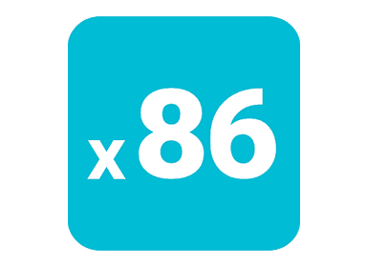
Framework and Methodology
Methodology
Setup: NASM assembler, x86 (32-bit), Linux OS.
Randomization: System time-based random number generation (1–100).
Game Loop: Prompts user, compares guess, and provides feedback.
Error Handling: Validates input and handles errors gracefully.
System Architecture
Language: Assembly (x86, 32-bit)
Assembler: NASM

Slide 6
Modules and Implementation
Initialization: Sets up data and memory, displays instructions.
Random Number Generator: Generates a random number (1–100) using system time.
Input Handling: Reads and converts user input (ASCII to integer).
Game Logic: Validates guesses, tracks attempts, and checks win/lose conditions.
Output Handling: Displays feedback (e.g., "Too high", "Correct guess").
Exit: Ensures program termination.

Slide 7
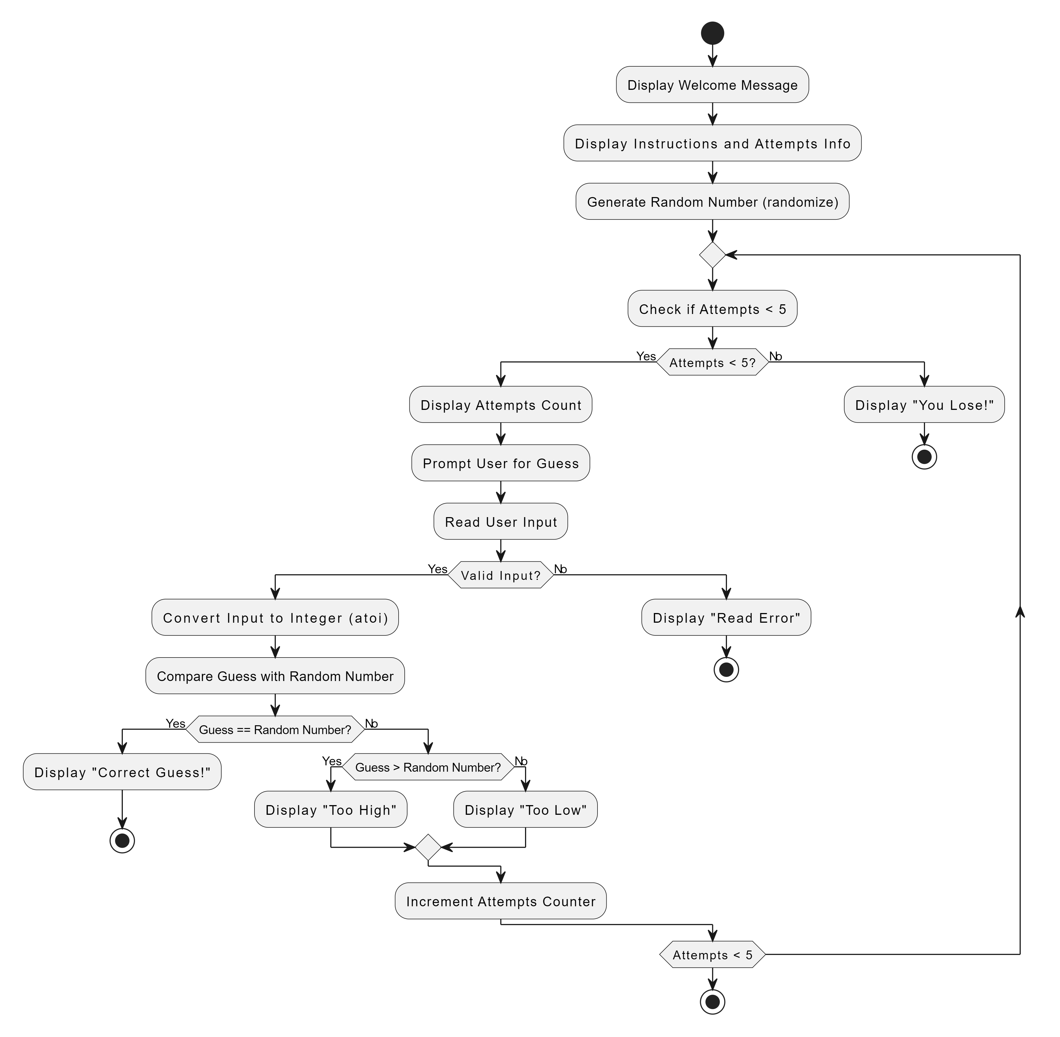
Flow Diagram

Slide 8
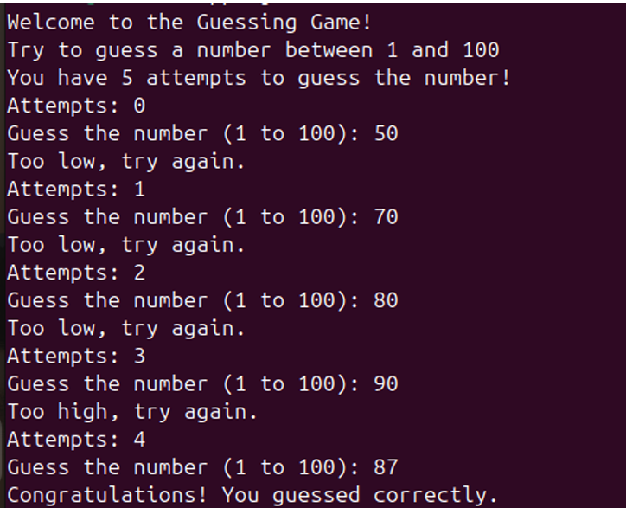
Screenshot

Slide 9
Future Work
Difficulty Levels:
Varying number ranges (e.g., 1-50, 1-200) and attempts based on difficulty.
Leaderboard:
Track high scores across multiple game sessions to encourage competition.
Multiplayer Mode:
Introduce competitive or cooperative guessing between multiple players.

Slide 10

Thanks
Do you have any questions

